Slide 1



Data analysis of livable conditions in selected cities in India based on Sustainable Development Goals
Team Members:
Name: R. Sanjna Sukirti
Roll No: 2023PECCS368
Department: Computer Science and Engineering
Domain: Data Analytics
Guide Name: Dr.M.Krishnamoorthy
Type of Project: Research
Date: 28-10-2025

Slide 2
AGENDA
Introduction & Objectives
Literature Survey
Problem Statement
System Architecture & UML Diagrams
Modules Overview
Methodology
Testing & Performance Analysis
Implementation - Web App Demo
Conclusion & Future Work

Slide 3
INTRODUCTION
This project focuses on assessing the urban livability of major Indian cities using a data-driven approach.
It aligns with the United Nations Sustainable Development Goals (SDGs 1, 3, and 11) related to poverty, health, and sustainable cities.
The study evaluates multiple dimensions including Air Quality, Health, Population Density and Poverty levels.
A composite Livability Index (LI) is developed by normalizing and combining these indicators.
An interactive Streamlit web application is created to visualize trends, compare cities, and interpret livability results dynamically.

Slide 4
OBJECTIVES
To analyze and compare the livability of five major Indian cities from 2019–2023.
To normalize and integrate multiple socio-environmental indicators into a single Livability Index.
To visualize trends and relationships among sub-indices and overall livability.
To develop a user-friendly web interface for dynamic exploration of results.
To support urban policy and planning through data-based insights.

Slide 5
LITERATURE SURVEY
S. No | Author & Year | Title | Technique Used | Result / Findings
1. | Salve et al. (2020) | Livability-Analysis of People’s Living Comfort in Different Cities of India Using GIS: A Prototype | Geographic Information System (GIS), Dimensional Index, Z-Score, Decile Scale Ranking | Developed livability visualization system; GIS and indices effectively assess city livability.
2. | Shruti et al. (2021) | Evaluating the Environmental Sustainability of Smart Cities in India: The Design and Application of the Indian Smart City Environmental Sustainability Index | Smart City Environmental Sustainability Index (SCESI), 24 indicators, 0–100 scale | Found Delhi and Bhubaneswar performed fairly; Varanasi and Patna lagged; SCESI effectively highlights sustainability gaps.
3. | Saeed et al. (2022) | An Integrated Approach for Developing an Urban Livability Composite Index—A Cities’ Ranking Road Map to Achieve Urban Sustainability | Analytical Hierarchy Process (AHP), Geometric Mean, spatial & non-spatial data | Revealed disparities among cities; Lahore highest, Rawalpindi strong in well-being and environment; useful for policy decision-making.
4. | Jayanandini et al. (2023) | Evaluating the Urban Liveability Index with Data-Driven Insights of Smart Cities Using Smart Innovative Solutions | Urban Liveability Index Analysis for Indian Cities (ULIA-IC), 15 cities | Achieved high accuracy and consistency; ULIA-IC serves as an effective decision-support tool for urban planning.
5. | Safiullah & Kumar (2023) | Review of Performance Indicators of Smart Cities in India – Ease of Living Index: A Case of Lucknow Smart City | Ease of Living Index (EOLI) case study to evaluate city governance | Identified data and governance gaps; emphasized need for improved data quality and citizen-inclusive approaches.

Slide 6
LITERATURE SURVEY
S. No | Author & Year | Title | Technique Used | Result / Findings
6. | Gareiou et al. (2023) | Review of Composite Environmental Indicators | Review of composite indices (SDG Index, Ecological Footprint, Environmental Performance Index) | Concluded that composite indices effectively measure environmental quality and sustainability progress.
7. | Thorat et al. (2023) | Analyzing Liveability Index Parameters for Formulating Assessment Model at the Zone Level – A Case of Pune City | Zonal assessment framework, safety, health, education, mobility | Found zonal disparities in livability; framework helps in policy prioritization and targeted improvements.
8. | Subramanian (2024) | Comparing Ease of Living Parameters & Urban Greening Index | Landsat 8 Remote Sensing, Geographic Information System (GIS), Urban Greening Index (UGI) | Found EOLI green indicators inadequate; suggested qualitative and perception-based indicators for better assessment.
9. | Ran et al. (2024) | Coordination Analysis Between Urban Livability and Population Distribution in China’s Major Urban Agglomerations | Coordination Distance Index (CDI), socioeconomic & ecosystem service data | Observed improvement in YRD and PRD coordination; method supports urban planning and population regulation.
10. | Satiawan et al. (2024) | Towards a Liveable City: Measuring the Liveability Index in Tuban Regency, East Java | District-level pre/post-pandemic measurement | Found rural areas performing better in environment, food security, and housing; highlighted spatial variations in livability.

Slide 7
LITERATURE SURVEY
S. No | Author & Year | Title | Technique Used | Result / Findings
11. | Yan et al. (2025) | Establishment of the Indicator System for Livable Cities Based on Sustainable Development Goals and Empirical Research in China | Sustainable Development Goals (SDGs)-oriented indicator system, ILCSD | Demonstrated that livable city indicators align with and promote SDG implementation.
12. | Hande et al. (2025) | Integrating Sustainable Development into Urban Management: A Strategic Green City Index for Cities | Green City Index (GCI), Analytical Hierarchy Process (AHP) | Found weak overall environmental performance (max 59/100); valuable tool for sustainable urban management.
13. | Rajesha & Chandrashekara (2025) | Exploring Urban Liveability: Frameworks and Approaches for Sustainable Cities | Secondary data review, urban sustainability frameworks | Emphasized integrated, cross-sectoral approaches linking livability with environmental, social, and economic sustainability.
14. | Mostafa et al. (2025) | Spatial Analysis and Ranking of Urban Districts Based on a Comprehensive Livability Approach: The Case of Tehran | Analytical Hierarchy Process (AHP), Factor Analysis, Hot Spot Analysis, Network Analysis | Found northern districts most livable; stressed spatial justice and citizen participation in urban planning.

Slide 8
PROBLEM STATEMENT
Rapid urbanization in Indian cities is worsening living conditions, with increasing pollution, overcrowding, poverty, and poor healthcare.
There is a lack of a unified, data-driven framework to evaluate overall city livability.
Existing reports often analyze isolated indicators, not an integrated livability measure.
Few frameworks integrate citizen participation, spatial justice, or provide visualization tools for effective urban planning.
Decision-makers and citizens need an accessible tool to explore and compare urban livability.
The project aims to develop a composite Livability Index and an interactive dashboard for visualization.

Slide 9
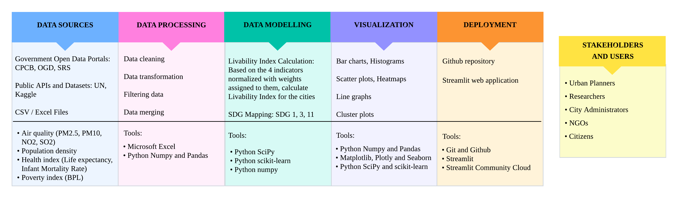
ARCHITECTURE DIAGRAM

Slide 10
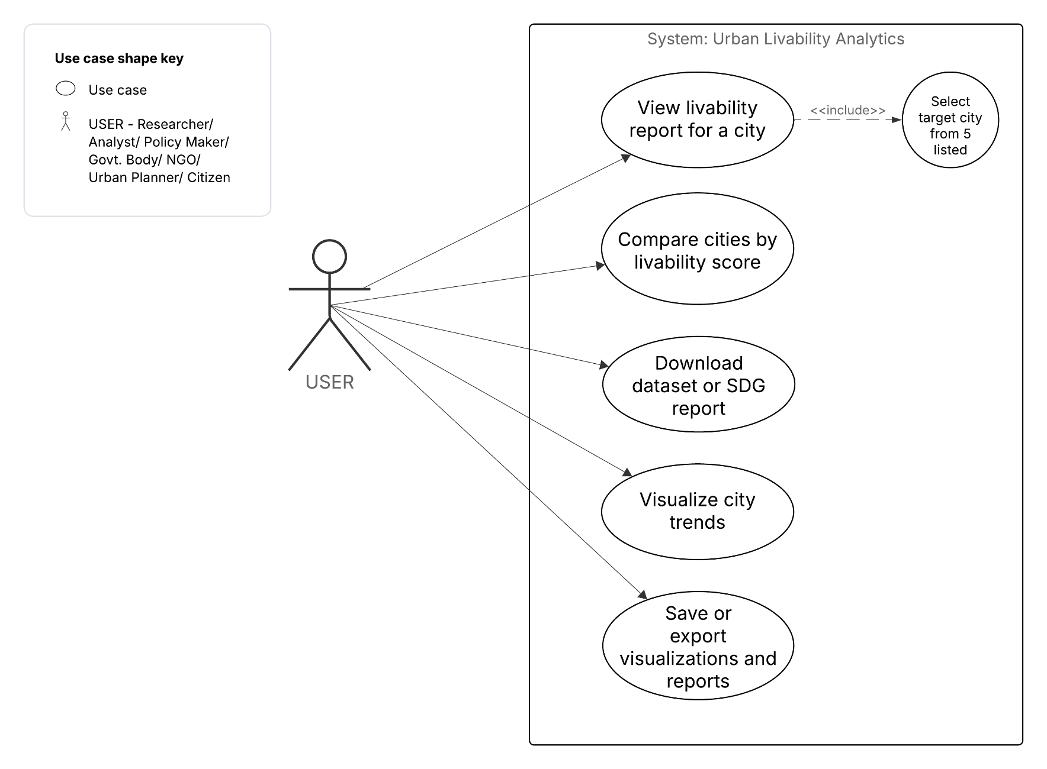
UML - USE CASE DIAGRAM

Slide 11
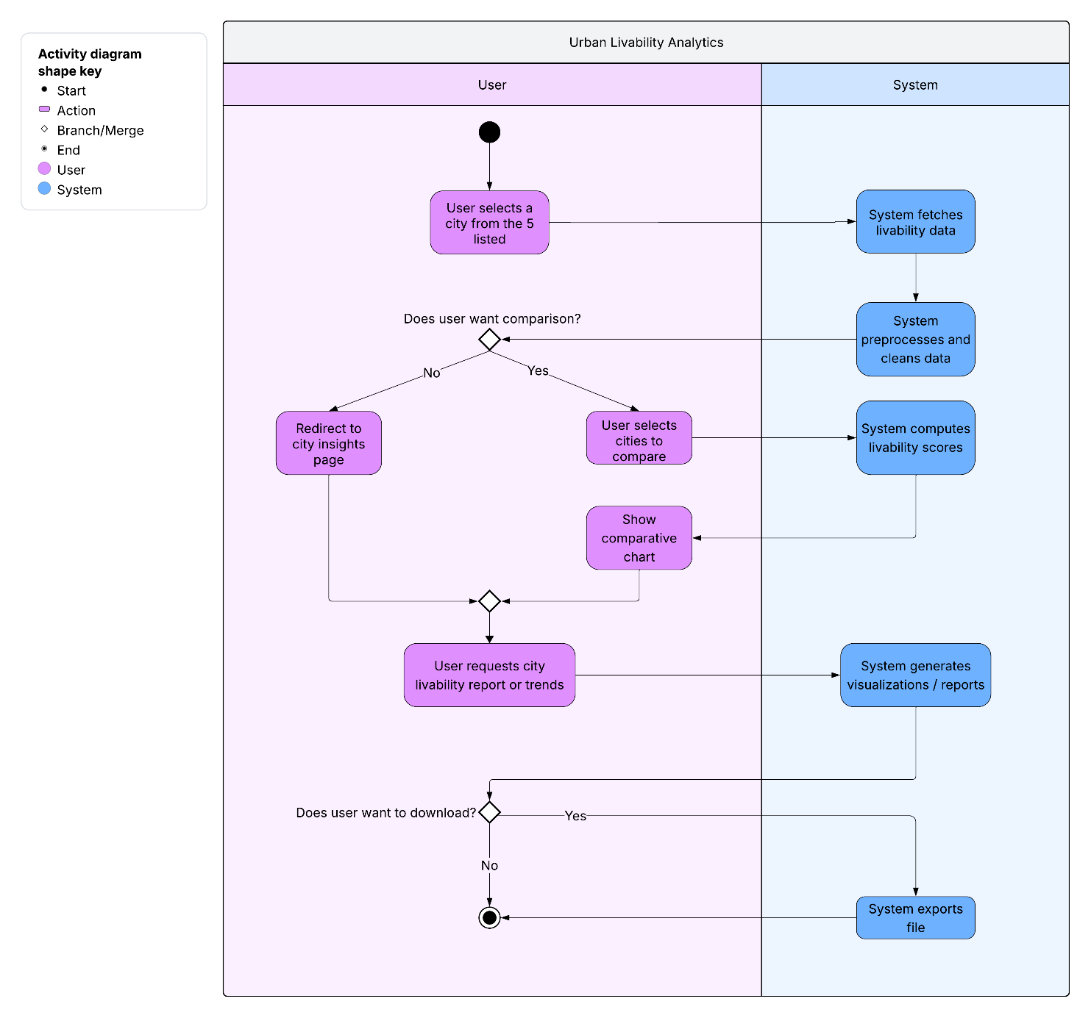
UML – ACTIVITY DIAGRAM

Slide 12
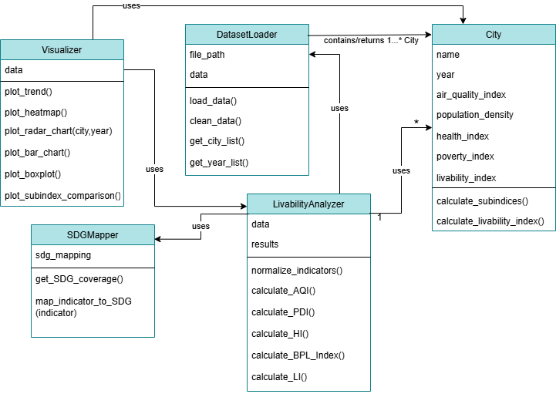
UML – CLASS DIAGRAM

Slide 13
MODULES DESCRIPTION
The key modules of the application include:
City Analysis Module – Displays sub-index and overall livability index for a selected city and year, highlighting key contributing factors.
Comparison Module – Compares multiple cities across chosen years and indicators to reveal differences in livability and development patterns.
Visualization Module – Showcases analytical and interactive visualizations such as line charts, heatmaps, radar plots, bar graphs, and distribution plots to interpret patterns and trends among various urban indicators.
Leaderboard Module – Ranks cities by overall livability scores, providing a comparative summary of their performance over time.
The backend computations are performed using Pandas and NumPy for data processing, while Matplotlib and Seaborn are used for generating plots integrated into the Streamlit front-end.
The interactive web dashboard provides a dynamic, multi-page interface for visualizing and comparing livability metrics across cities and years.

Slide 14
METHODOLOGY
Five major Indian cities - Delhi, Mumbai, Bengaluru, Chennai, and Kolkata - were analyzed for the period 2019–2023, using available data.
The composite Livability Index (LI) for each city and year was calculated by taking weighted average with equal weights (w_{i} = 0.25) for 4 sub-indices based on UN standards. Min–Max normalization was applied to standardize all indicators (0–1 scale), ensuring comparability.
Missing city-level data were substituted with state/metropolitan proxies.
Formula: 𝐿𝐼=𝑤1(𝐴𝑄𝐼)+𝑤2(𝐻𝐼)+𝑤3(𝑃𝐷𝐼)+𝑤4(𝐵𝑃𝐿_𝐼𝑛𝑑𝑒𝑥) and 𝐿𝐼%=𝐿𝐼×100
Indicators:
AQI - Air Quality Index (PM2.5, PM10, NO2, SO2)
HI - Health Index (Life expectancy, Infant mortality rate)
PDI - Population Density Index (Population, area, population density)
BPL_Index - Poverty Index (Below poverty line population).

Slide 15
METHODOLOGY
Air quality indicators were obtained from the Kaggle datasets which are based on Central Pollution Control Board (CPCB) Air Quality data.
Health indicators were sourced from the Sample Registration System (SRS) and National Family Health Survey data.
Socio-economic data were obtained from the Open Government Data (OGD) platform and state-level poverty reports.
Demographic data were collected from the Census of India, with updated estimates from respective city and metropolitan area municipal corporations.

Slide 16
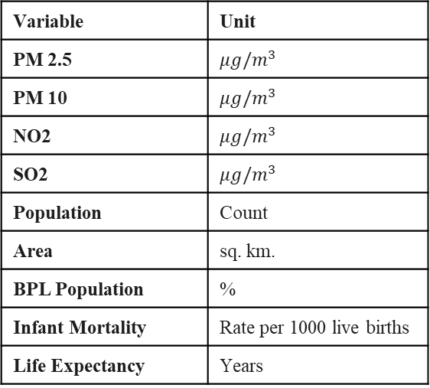
DATASET SAMPLE
Year | City | Pm2.5 | Pm10 | No2 | So2 | Population | Area | Bpl_population | Infant_mortality_rate | Life_expectancy
2019 | Chennai | 34.6 | 82.15 | 15.25 | 7.17 | 10711000 | 1189 | 2.2 | 15 | 73
2020 | Bangalore | 30.36 | 72.3 | 22.42 | 3.12 | 12327000 | 8005 | 7.58 | 19 | 69.6
2021 | Mumbai | 36.45 | 127.11 | 27.2 | 9.71 | 20668000 | 6328 | 7.81 | 15 | 72.5
2022 | Delhi | 114.24 | 230.63 | 44.38 | 15.48 | 32066000 | 1483 | 2.97 | 12 | 74.6
2023 | Kolkata | 44.17 | 97.4 | 15.46 | 15.77 | 15333000 | 1876 | 8.6 | 17 | 72.1
Dataset Overview
Variable Definition Table
Variable | Unit
PM 2.5 | $$μg/m^{3}$$
PM 10 | $$μg/m^{3}$$
NO2 | $$μg/m^{3}$$
SO2 | $$μg/m^{3}$$
Population | Count
Area | sq. km.
BPL Population | %
Infant Mortality | Rate per 1000 live births
Life Expectancy | Years
Metric | Value
Total Observations (Rows) | 25 (5 cities * 5 years)
Total Features (Columns) | 11
Time Period | 2019 - 2023 (5 years)
Geographical Scope | 5 Major Indian Cities: Chennai, Bangalore, Mumbai, Delhi, Kolkata
Variable Groups | Air Quality (PM2.5, NO2, SO2, PM10), Demographics (Population, Area, BPL), Health (IMR, Life Expectancy)

Slide 17
TESTING AND VALIDATION
Testing Performed:
Functional testing of all Streamlit modules.
Data validation for missing or incorrect values.
Integration testing for inter-module consistency.
Usability testing for clarity and responsiveness.
Test Case | Expected Result
City-wise Analysis | Correct sub-index and livability display.
Comparison Module | Accurate multi-city results.
Visualization Rendering | All charts and graphs load properly.
Leaderboard | Correct city ranking based on Livability Index.
Normalization | All values between 0–1 verified for sub-indices.
Validation Results:
Cross-checked computed sub-indices with manual calculations.
Consistent and reproducible normalization confirmed.

Slide 18
PERFORMANCE ANALYSIS
Quantitative Metrics:
Computation for all cities and years completed in less than 2 seconds.
Memory usage below 100 MB.
Visualization load time: 1-2 seconds per chart.
Qualitative Assessment:
Stable and responsive user interface.
Real-time updates during user interaction.
100% functionality coverage across modules.
The livability index model and Streamlit dashboard deliver accurate, efficient, and user-friendly performance across all analytical and visualization tasks.

Slide 19
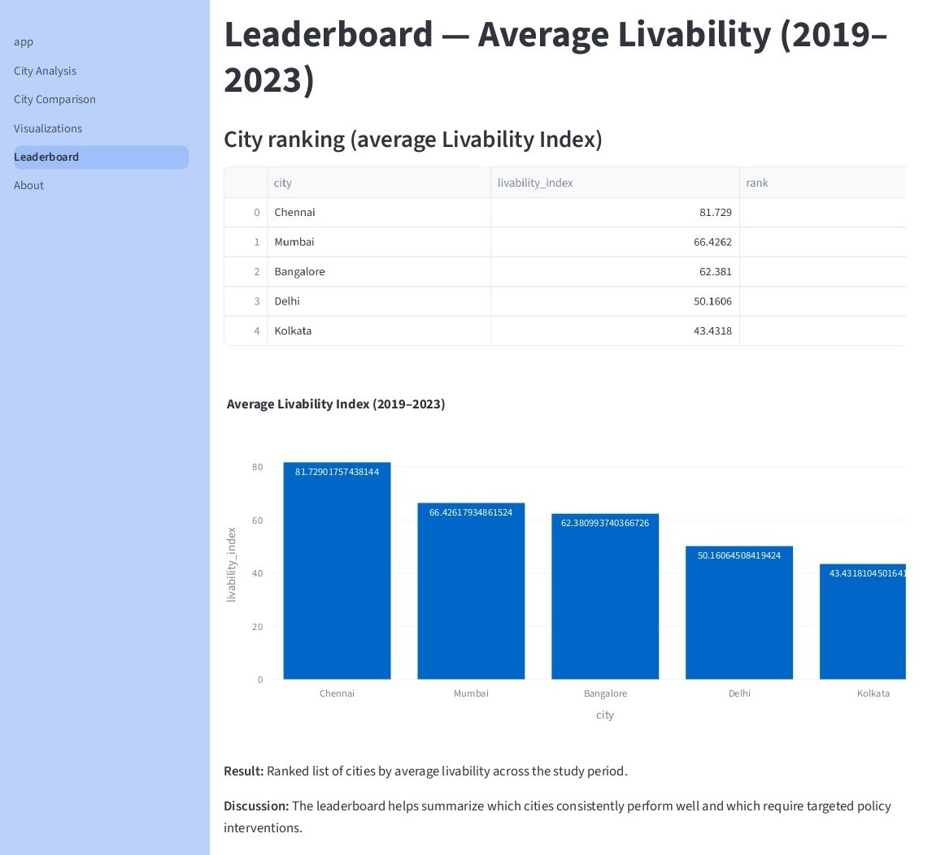
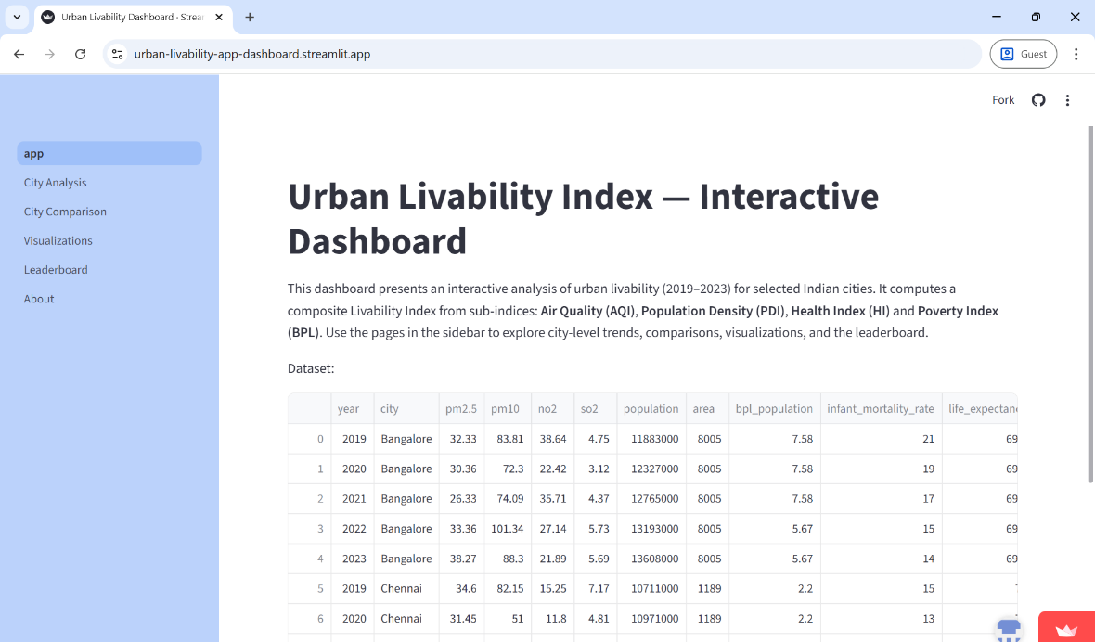
SCREENSHOTS
Live Link - Urban Livability App
Github Link - Github Urban Livability App

Slide 20
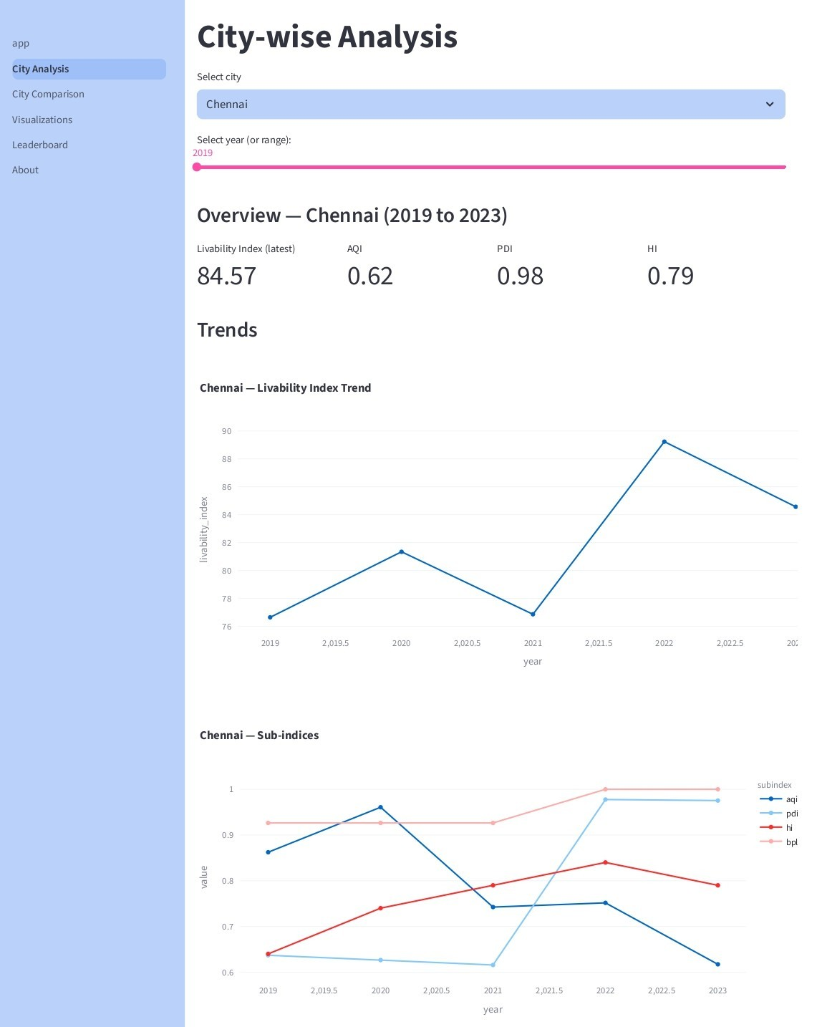
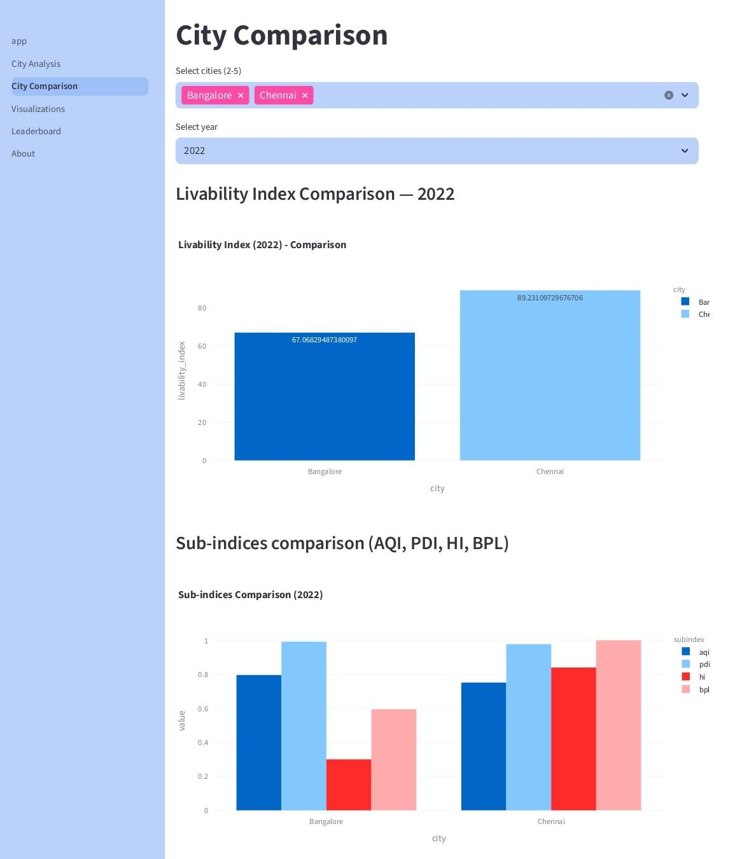
SCREENSHOTS

Slide 21
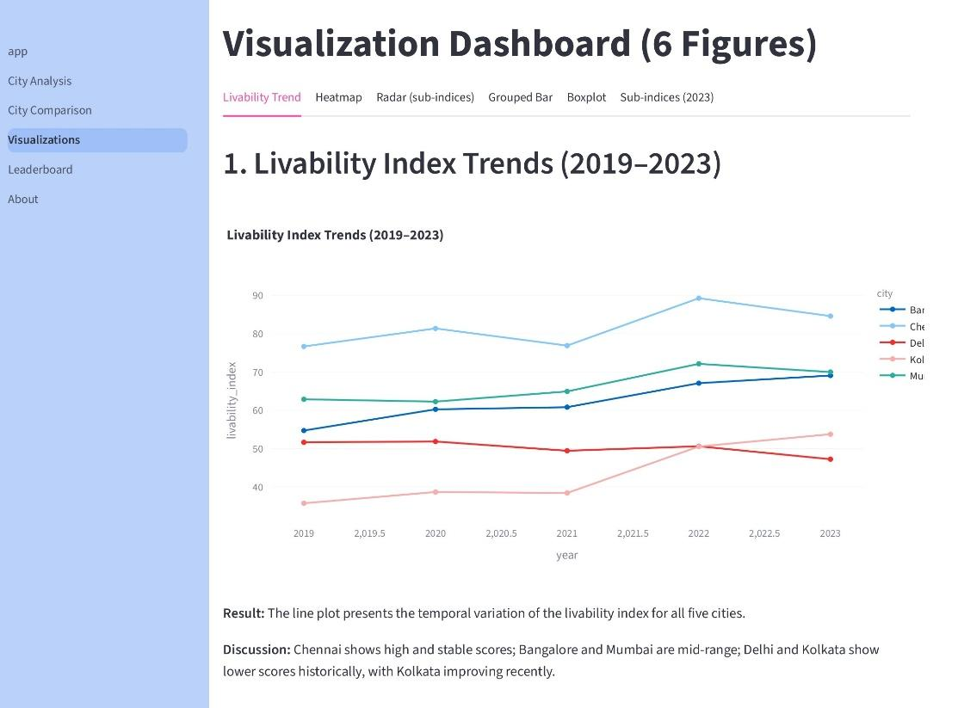
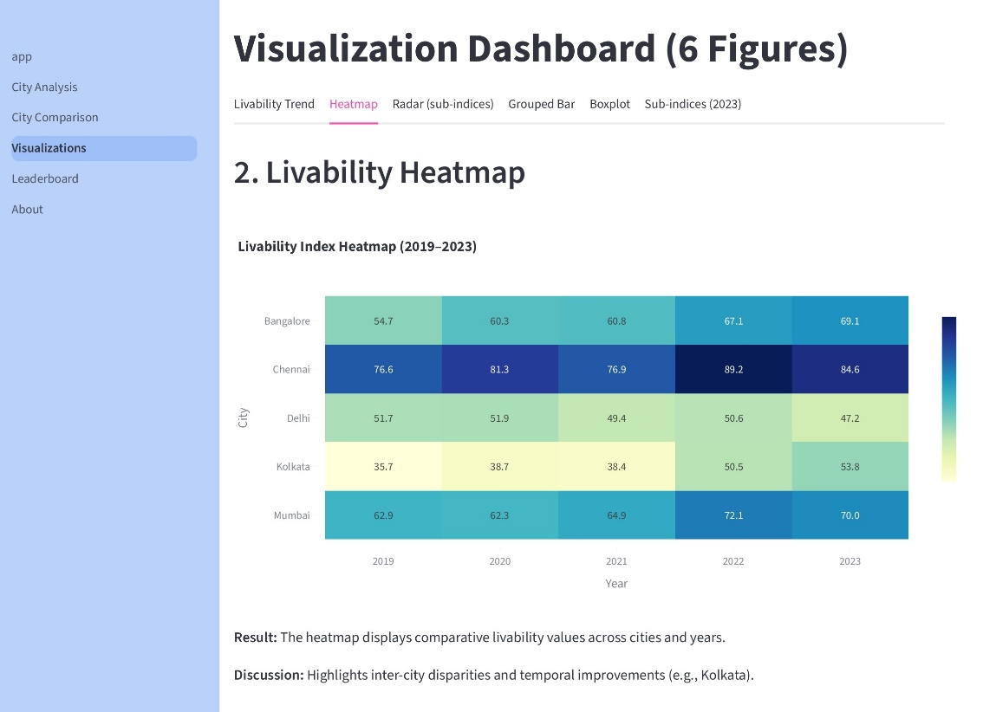
SCREENSHOTS

Slide 22
CONCLUSION
In conclusion, this research analyzed livability in selected Indian cities by examining key Sustainable Development Goals (SDG) indicators such as air quality, population density, health, and poverty. The analysis revealed significant differences in livability not only between cities but also across the various sub-indicators measured.
Chennai - balanced performance driven by consistent policy efforts.
Delhi - major challenges, particularly in air quality and population density.
Kolkata - gradual improvement in health and poverty, but progress remains uneven.
Mumbai - steady performance across sub-indices.
Bangalore - excels in population density and healthcare but faces challenges in poverty and infrastructure.
Overall, the study emphasizes the need for targeted, SDG-driven policies to improve urban livability across diverse Indian cities.

Slide 23
FUTURE SCOPE
To develop a more extensive understanding of urban livability aligned with sustainability standards, future research should incorporate a wider range of indicators beyond air quality, population density, health, and poverty.
Metrics that cover other aspects of infrastructural development and also social and economic development are also essential for capturing sustainable urban development comprehensively.
Leveraging emerging technologies like AI, IoT, and big data analytics can also support real-time data collection and smarter urban management strategies.

Slide 24
REFERENCES
Shrikant Salve, Shubham Bombarde, A. Agrawal, Smruti Paldiwal, B. S. Roy, and Bhagyashree Alhat, “Livability-Analysis of People’s Living Comfort in Different Cities of India Using GIS: A Prototype,” HAL (Le Centre pour la Communication Scientifique Directe), pp. 163–168, May 2020, doi: https://doi.org/10.18573/book3.u.
S. Shruti, P. K. Singh, and A. Ohri, “Evaluating the Environmental Sustainability of Smart Cities in India: The Design and Application of the Indian Smart City Environmental Sustainability Index,” Sustainability, vol. 13, no. 1, p. 327, Dec. 2020, doi: https://doi.org/10.3390/su13010327.
U. Saeed, S. R. Ahmad, G. Mohey-ud-din, H. J. Butt, and U. Ashraf, “An Integrated Approach for Developing an Urban Livability Composite Index—A Cities’ Ranking Road Map to Achieve Urban Sustainability,” Sustainability, vol. 14, no. 14, p. 8755, Jul. 2022, doi: https://doi.org/10.3390/su14148755.
“View of Review of Performance Indicators of Smart Cities in India –Ease of Living Index: a case of Lucknow Smart City,” Safer.uct.cl, 2025. https://safer.uct.cl/index.php/SAFER/article/view/445/403 (accessed Sep. 24, 2025).
D. Subramanian, “Comparing Ease of Living parameters & Urban Greening Index,” E3S Web of Conferences, vol. 559, p. 04047, 2024, doi: https://doi.org/10.1051/e3sconf/202455904047.

Slide 25
Thank you
Question & Answers

